Slide 1

Compiler Design
Preet Kanwal
Department of Computer Science & Engineering
Teaching Assistant : Sanket N D

Slide 2

Compiler Design Lecture Overview
In this lecture, you will learn about -
What are parsers?
Role of a Parser
Error Recovery Strategies in Parsers
Overview of Types of Parsers
Top-down and Bottom-Up Parsers

Slide 3
Compiler Design
Unit 2
Parsers and Error Recovery Strategies
Preet Kanwal
Department of Computer Science & Engineering

Slide 4
Compiler Design What is a Parser?
Parser, also called a Syntax Analyzer, is a program which takes as input a grammar G and a string w to produce a parse tree for w, if the string w belongs to the language of grammar G else throws an error.
Note - Input is read from left to right.

Slide 5
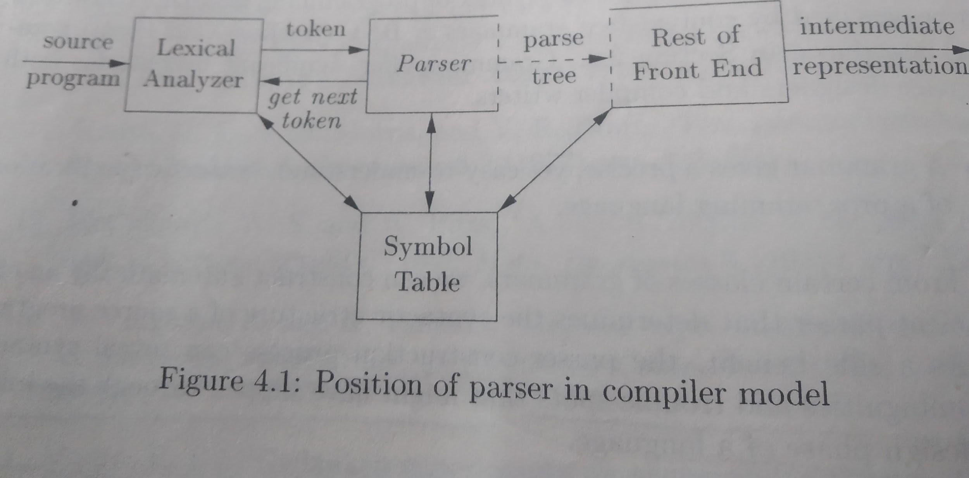
Compiler Design What is a Parser?
Parser, also called a Syntax Analyzer, is a program which takes as input a grammar G and a string w to produce a parse tree for w, if the string w belongs to the language of grammar G else throws an error.
Note - Input is read from left to right.

Slide 6
Compiler Design Role of a Parser
The Role of a parser is-
To validate the syntax of the program.
To construct a parse tree and pass it to the semantic analyzer in the compiler.
To store information in the symbol table about tokens received from the lexer.
Report syntax errors.

Slide 8
Compiler Design
Properties of Error Messages
The compiler must report errors by generating messages of the following format -
The message must pinpoint the error - for example, the line number of the statement containing the error.
The message should be specific and must localize the problem.
Eg: Undeclared variable in function foo() at line 29.
The message should be clear and understandable.
Messages should not be redundant. For example, if an undeclared variable is referenced 20 times, the error should be displayed only once.

Slide 9
Compiler Design
Types of Errors
Common programming errors can occur at many different levels.
• Lexical errors include misspellings of identifiers, keywords, or operators — e.g., the use of an identifier elipseSize instead of ellipseSize — and missing quotes around text intended as a string.
• Syntactic errors include misplaced semicolons or extra or missing braces; that is, "{ " or "}. " As another example, in C or Java, the appearance of a case statement without an enclosing switch is a syntactic error (however, this situation is usually allowed by the parser and caught later in the processing, as the compiler attempts to generate code).
• Semantic errors include type mismatches between operators and operands. An example is a return statement in a Java method with result type void.
• Logical errors can be anything from incorrect reasoning on the part of the programmer to the use in a C program of the assignment operator = instead of the comparison operator ==. The program containing = may be well formed; however, it may not reflect the programmer's intent.

Slide 10
Compiler Design
Error Recovery Strategies
Error Recovery Strategies

Slide 11
Compiler Design
Error Recovery in Parsers
There is no universally accepted strategy for error recovery in Parsers.
Some simples strategies would be to quit with an informative error message (eg. python), or gather additional errors before quitting (eg. C), presuming it is possible to restore the parser state where it can continue processing.
There are four commonly used error recovery strategies -
Panic Mode Recovery
Phrase level Recovery
Error Productions
Global Corrections

Slide 12
Compiler Design
Error Recovery Strategies
1. Panic Mode Recovery
The parser will discard the input symbols until it finds a delimiter such as semicolon or} and then restart the parsing process.
Such delimiters are called synchronizing tokens.
Consider the following expression - (1 + + 2) + 3
In this case, we skip ahead to next integer and continue parsing.
Its very simple method and will not go to infinite loop

Slide 13
Compiler Design
Error Recovery Strategies
2. Phrase level recovery
This involves performing local
corrections in the input
program, in case it contains errors.
For example,
missing semicolon ; - insert it
missing closing bracket ) - insert it
The choice of the correction is left to the compiler designer. However, it needs to be done carefully.
Incorrectly inserting characters could cause the program to perform erroneously.

Slide 14
Compiler Design
Error Recovery Strategies
3. Error productions
The idea here is to specify in the grammar known common mistakes.
For example,
S → if (cond) {S} else {S} is grammar for valid if-else code.
S → fi (cond) {S} else {S}
can be written as an error production, with action being a more informative message about the error to the user.
Disadvantage - It complicates the grammar.

Slide 15
Compiler Design
Error Recovery Strategies
4. Global Correction
Extremely hard to implement
Takes the grammar and the input program (with errors) as input, and passes them to the algorithm to find a program(string) y that is closest correct program to the original program x.
This has minimal changes done to x.
Disadvantages
The closest correct program y may not exactly be what the programmer intended to write.
It slows down parsing of correct programs and expensive.

Slide 16
Compiler Design
Error Recovery Strategies
Types of Parsers

Slide 17
Compiler Design
Types of Parsers - An Overview
Parsers
Top-down
Universal (CYK)
Bottom-up
Predictive Parser/LL(1)
RDP
Shift reduce parsing
Table driven LR
Parsers
With backtracking
Without backtracking
LR (0)
SLR (1)
LALR (1)
CLR (1)

Slide 18
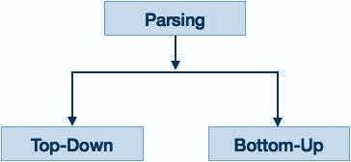
Compiler Design Types of Parsers
There are mainly two types of parsers - top-down parsers and bottom-up parsers.
A Top-down Parser generates parse tree for the given input string with the help of grammar productions by expanding the non-terminals.
It starts from the start symbol and ends on the terminals.
It uses left most derivation.
A Bottom-up Parser generates the parse tree for the given input string with the help of grammar productions by compressing the non-terminals
It starts from terminals and ends on the start symbol.
It uses the reverse of the rightmost derivation.

Slide 19
THANK YOU
Preet Kanwal
Department of Computer Science & Engineering
preetkanwal@pes.edu

